Slide 1

SEE Award 2025
[Enter your project title here – this will be the first slide of your PPT]

Slide 2
Instruction slide
Please read this carefully:
Once you have finished your template, please delete slides 2, 3 and 4. They are intended to provide you with an overview of the main things to keep in mind.
Please stick to the slide count and format do not add additional slides, unless specifically instructed to do so.
You can upload supporting documentation and / or videos in support of this PPT using the specific upload button.
You will find a separate upload button to upload the investor reference letter. Remember that this is mandatory for your submission to be considered.
You will find useful tips and information on what to avoid on the website.

Slide 3
Define & align your project
Skill enhancement
Employability
The combination of skills, knowledge, personal attributes, and attitudes that make an individual capable of finding, maintaining, and progressing in meaningful employment.
Employment Quality
The overall conditions and standards of a job, including factors such as fair pay, job security, safe working conditions, opportunities for growth, work-life balance, and respect for inclusive workers' rights.
The abilities, knowledge, and expertise individuals acquire through education, training, or experience that enable them to perform tasks or roles effectively in a specific field or context.
Overall outcomes for the project are:
Outcome 1: Awardees scale-up innovative, skills-driven employment and job quality enhancement initiatives that improve workforce capabilities and promote inclusion.
Outcome 2: Employees and job seekers, including from marginalized groups, gain access to enhanced skill-building opportunities, leading to improved employability, better wages, and improved career prospects.
Score higher if:
Your project has an EDI focus.
You include an in-house contribution towards the overall budget at 15% or more.
To be eligible for the award process:
It is mandatory to include a reference letter from your investor (see point 5 under award criteria – Impact Potential).
Project duration:
12-months for 50k award
18-months for the 100k award
24-months for the 150k

Slide 4
Link your project to the evaluation criteria
Impact Potential
Clear goals with measurable improvements in skills, employability, and job quality.
Targets diverse groups; inclusion of women and marginalized groups scores extra points.
Measurable results: increased skills, promotions, wages, or job satisfaction.
Creates impact at individual, team, and organizational levels, aligned with inclusivity/sustainability.
Investor reference check.
Scalability
Designed for growth, inspiring adoption across teams, departments, or industries.
Maintains benefits for original target groups during scaling.
Clearly identifies resources (funding, tools, staff) for effective scaling.
Balances cost-effectiveness with goals like sustainability and long-term growth.
Innovation and Collaboration
Introduces novel ideas, tools, or methods relevant to its context.
Improves workflows and addresses challenges in employability or job quality.
Fosters collaboration across teams and stakeholders, driving inclusivity and productivity.
Sustainability
Ensures long-term impact without constant external support.
Efficient resource use enhances well-being and organizational/community growth.
Develops a healthy work environment as part of its sustainability framework.
Aligns with company values, fostering a positive work culture.
Alignment with Local Needs
Addresses specific local challenges (skills gaps, onboarding, working conditions).
Ensures relevance with input from employees, job seekers, and managers.
Evaluation Process
Includes a clear evaluation process (e.g., surveys, interviews) to measure success.
Applies findings to improve future initiatives and working conditions.

Slide 5
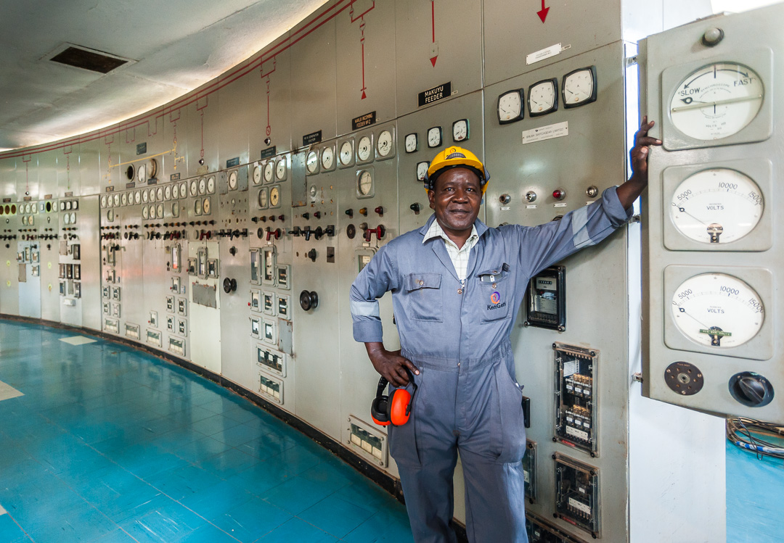
About our institution
Name of Institution:
Country:
Project lead / main contact for the submission:
Email address(s):
Mailing address:

Slide 6
About our team

Slide 7

Section 1: The Blueprint
Introduce your project
7

Slide 8
The blueprint
In one sentence each, provide the project name, its purpose and impact.
You can put a photo that best captures your focus on the left.
Please delete the instructions once you have filled in your information.
Project name
Project purpose
Impact

Slide 9

The foundation
To begin with, can you use either 1 question, 1 challenge or 1 interesting fact to grab our attention for the problem / challenge you address.
Then use the remainder of the space in this box to explain who is affected and how, and what the connection to skills, employability, and/or employment quality is.
You can put a photo that best captures your challenge on the right.
Please delete the instructions once you have filled in your information.

Slide 10
The framework
Skill enhancement
Employability
The combination of skills, knowledge, personal attributes, and attitudes that make an individual capable of finding, maintaining, and progressing in meaningful employment.
Employment Quality
The overall conditions and standards of a job, including factors such as fair pay, job security, safe working conditions, opportunities for growth, work-life balance, and respect for inclusive workers' rights.
The abilities, knowledge, and expertise individuals acquire through education, training, or experience that enable them to perform tasks or roles effectively in a specific field or context.
Select the thematic area(s) your project addresses and present it in one box.
You can leave the definition provided or provide your own and delete the other ones.
If your project addresses multiple areas, explain how they are interconnected in an additional box.
You can put a graphic or photo that best captures your thematic area instead of this box.
Please delete the instructions once you have filled in your information.

Slide 11
The building blocks
Select all HR areas your project addresses. You can add / remove areas, as you see fit.
In this box, provide a short description of how our project intends to tackle these areas, and any results anticipated.
Please delete the instructions once you have filled in your information.
Recruitment and onboarding.
Training and development.
Performance appraisals and feedback.
Career progression and succession planning.
Employee engagement and retention.
Compensation and benefits.
Diversity, equity, and inclusion.
Workplace safety.
Employee well-being (mental and physical health).
Job matching or skills alignment.
Internships, apprenticeships, or job placements.
Other [specify]

Slide 12

Section 2: The Construction Site
What does your project consist of?
12

Slide 13
Instruction slide
Explain how your project addresses a specific need in skills enhancement, employability, employment quality and the results you aim to achieve.
Include what it consists of, implementation details, key stakeholders, and challenges faced for each focus area.
To do this, please select the specific slide (14 – 17) and delete the other slides.
Slide 14: Skills enhancement
Slide 15: Employability
Slide 16: Employment quality
Slide 17: 2 or 3 thematic areas combined in one project.
You can present up to 5 slides for this section, using the table format (this is applicable if you develop one or several of the thematic areas). For the implementation plan, you can use Slide 20. You are welcome to adapt the timeline chart as you see fit. Kindly provide 1 slide for the implementation plan.
Please delete the instruction slide once you have filled in your information.

Slide 14
The skills wing:
Developing workforce capabilities
The need | What is the need for skills enhancement, and how was it identified? Highlight specific local challenges the project is intending to address.
What it consists of | Describe the training, upskilling, reskilling programs, or any other form of skills enhancement your project offers. Share adaptations made to fit local cultural or operational contexts.
Implementation | How is the project being implemented? What are the main activities and timelines? What resources are required?
Who is involved and how | Identify the key stakeholders, their roles and responsibilities. Show how they are being consulted in the design process.
Challenges and solutions | What challenges have you faced / are you facing, and how are they being overcome?

Slide 15
The employability wing:
Opening pathways to jobs
The need | What is the need for improving employability? Highlight specific local challenges the project is intending to address.
What it consists of | Describe how your project improves access to jobs, career pathways, or job placements. Share adaptations made to fit local cultural or operational contexts.
Implementation | How is the project being implemented? What are the main activities and timelines? What resources are required?
Who is involved and how | Identify the key stakeholders, their roles and responsibilities. Show how they are being consulted in the design process.
Challenges and solutions | What challenges have you faced / are you facing, and how are they being overcome?

Slide 16
The employment quality wing:
Building better workplaces
The need | What is the need for improving employment quality, and how was it identified? Highlight specific local challenges the project is intending to address.
What it consists of | Describe how your project improves job / employment quality. Share adaptations made to fit local cultural or operational contexts.
Implementation | How is the project being implemented? What are the main activities and timelines? What resources are required?
Who is involved and how | Identify the key stakeholders, their roles and responsibilities. Show how they are being consulted in the design process.
Challenges and solutions | What challenges have you faced / are you facing, and how are they being overcome?

Slide 17
The connecting hallways:
Developing workforce capabilities
The connection | If your project combines multiple thematic areas (Skills Enhancement, Employability, Employment Quality), explain how they are integrated.
The need | What is the need for improving the 2 or 3 areas, and how was it identified? Highlight specific local challenges the project is intending to address.
What it consists of | Describe how your project improves the 2 or 3 areas identified. Share adaptations made to fit local cultural or operational contexts.
Implementation | How is the project being implemented? What are the main activities and timelines? What resources are required?
Who is involved and how | Identify the key stakeholders, their roles and responsibilities. Show how they are being consulted in the design process.
Challenges and solutions | What challenges have you faced / are you facing, and how are they being overcome?

Slide 18
Implementation plan
Use a timeline to demonstrate the project is being implemented. Specify the timeline, activities and milestones.
You can also add resources needed.
Please delete the instructions once done.
Q1
2OYY
xxx
Q2
20YY
Q3
20YY
xxx
xxx
Q4
20YY
xxx
xxx
xxx
xxx
xxx

Slide 19
The design studio
This is an instruction slide. Please delete it once you have filled in the design studio slides. You can use up to 2 slides for your theory of change. Slide 23 is a separate slide that provides a summary.
Components | Example (skills enhancement) | Measurement indicators
Goal Define the long-term change or impact you aim to achieve. This should reflect the ultimate societal, organizational, or individual transformation you want to see. | Clearly articulate the overarching objective (e.g., improving economic stability, reducing unemployment, or enhancing job satisfaction). Ensure the goal is specific enough to guide the rest of the framework but broad enough to encompass all related outcomes. | Identify metrics that reflect the achievement of the goal (e.g., % increase in employment rates, % improvement in income levels, % reduction in unemployment).
Inputs List the resources required to implement the interventions. | Identify the financial, human, and material resources needed (e.g., funding, trainers, infrastructure, partnerships). Be specific about what resources will enable the activities to take place effectively. | Track the availability and utilization of resources (e.g., total budget allocated, number of trainers hired, number of partnerships established).
Activities Outline the specific activities, actions or interventions carried out to achieve the outputs. | List all the key actions being implemented (e.g., conducting workshops, providing mentorship, organizing job fairs). Describe the nature of the activities to ensure clarity on what is being done. | Track the implementation of activities (e.g., number of workshops conducted, attendance rates, number of mentorship sessions provided).
Outputs Define the tangible, measurable deliverables that result from the activities. | Specify the immediate results of your activities (e.g., number of participants trained, number of workshops conducted, number of portfolios created). Ensure outputs are concrete and measurable. | Use metrics like # of participants trained, # of workshops conducted, # of portfolios completed.
Outcomes Articulate the intermediate changes or benefits resulting from the outputs. | Specify the changes in participants’ skills, knowledge, behaviour, or circumstances (e.g., improved job application confidence, increased efficiency, reduced errors). Ensure outcomes are realistic and achievable within a defined timeframe. | Use metrics like % improvement in efficiency, % reduction in workplace errors, % of participants securing job interviews.
Impact Describe the ultimate change or transformation at the societal, organizational, or individual level. | Specify the long-term effects of achieving the outcomes (e.g., increased employment rates, enhanced economic stability, improved job satisfaction). Ensure the impact reflects the program’s ultimate purpose. | Use metrics like % increase in employment rates, % reduction in unemployment, % improvement in organizational performance.

Slide 20
The design studio
This is an example slide. Please delete it once you have filled in the design studio slides.
Components | Example (skills enhancement) | Measurement indicators
Goal | Unemployed adults secure better job opportunities and achieve economic stability. | % of participants securing jobs within 6 months of completing the program. % increase in participants’ income levels. % reduction in unemployment rates in the target community.
Inputs | Funding for workshops and trainers. Curriculum development for coding, graphic design, and data analysis. Access to computers, software, and internet for participants. Partnerships with employers to understand skill demands. | Total budget allocated for the program. Number of trainers hired. Number of partnerships established with employers. Availability of training infrastructure (e.g., computers, software licenses).
Activities | Conduct hands-on training workshops in digital skills. Provide mentorship and career guidance during and after the workshops. Facilitate networking opportunities with potential employers. | Number of workshops conducted. Attendance rates for training sessions. Number of mentorship sessions provided.
Outputs | # of participants trained in specific digital skills.# of workshops conducted. Participants’ portfolios showcasing their hands-on projects. | 500 participants trained by 2025.20 workshops conducted over 12 months. 300 participants with completed portfolios.
Outcomes | Intermediate change: Participants gain practical digital skills and increased confidence in applying for jobs. Participants secure interviews and job offers in digital or related fields. Employers recognize participants’ skills and hands-on experience, leading to increased employment opportunities. | % of participants reporting increased confidence in job applications. % of participants securing interviews within 3 months of program completion. % of participants receiving job offers in digital fields.
Impact | Increased employment rates among participants. Enhanced economic stability and reduced unemployment in the community. | % of participants employed in digital or related fields within 6 months of program completion. % increase in average household income among participants.% reduction in unemployment rates in the target community.

Slide 21
The design studio
This is the slide that you will use to present your theory of change.
You can use up to 2 slides for your theory of change.
Goal
Inputs
Activities
Outcomes
Impact
Outputs
Indicators: Goal
Indicators: Inputs
Indicators: Activities
Indicators: Outcomes
Indicators: Impact
Indicators: Outputs

Slide 22

The design studio
This is an example slide.
Please delete once you have completed slide 23.
If
Then
75% of participants will demonstrate proficiency by 2025,
Because
Research shows that targeted training programs improve digital skills, and our baseline indicates only 30% have these skills.
We train participants in digital skills through a series of workshops, addressing the gap of only 30% proficiency,

Slide 23
The design studio
Please summarize your theory of change in three simple sentences using the if-then-because approach.
You can put a photo / info-chart that best captures your theory of change on the left.
Please delete the instructions once you have filled in your information.
If
Clearly define the action or intervention your project will implement, ensuring it is specific and measurable.
Link the intervention to the baseline data and describe how it addresses the identified need or gap.
Then
State the expected outcome or change resulting from the intervention, using SMART indicators.
Ensure the outcome is measurable and directly tied to the intervention (e.g., changes in skills, behaviours, or conditions).
Because
Provide the reasoning or evidence that connects the action to the expected outcome.
Use research, past results, or logical reasoning to explain why the intervention will lead to the intended change.
This is the activity / output level of your theory of change.
This is the outcome level of your theory of change.
This is the input level of your theory of change.

Slide 24
The measurement pillars
Baseline Data
Identify and report baseline values for SMART indicators that will be used to measure progress toward your Expected Results.
Expected Results
Define measurable improvements linked to baseline indicators using the SMART framework.
Ripple Effects
Specific: Clearly define what is being measured.
Measurable: Use quantifiable metrics.
Achievable: Reflect realistic starting conditions.
Relevant: Align with project objectives.
Time-bound: Specify when data was collected.
If baseline data is unavailable, outline plans to collect it (e.g., surveys, focus groups).
Include qualitative data to provide context and explain the need for intervention.
Ensure each expected result corresponds to a baseline value.
Include both quantitative and qualitative targets.
Examples:
Skill Enhancement:
Baseline: "30% lack digital skills (2023)."
Expected Result: "By 2025, 75% will demonstrate digital proficiency."
Employability:
Baseline: "Youth unemployment is 15% (2023)."
Expected Result: "By 2025, reduce unemployment to 10%."
Employment Quality:
Baseline: "25% satisfaction with workplace safety (2023)."
Expected Result: "By 2025, increase satisfaction to 70%."
Describe indirect or systemic changes inspired by expected results.
Ensure ripple effects logically build on measurable outcomes.
Highlight potential influence on policy, practices, or community resilience.
Examples:
Skill Enhancement:
Expected Result: "Increase digital proficiency to 75% by 2025."
Ripple Effect: "Inspires other organizations to adopt similar training programs."
Employability:
Expected Result: "Reduce youth unemployment to 10% by 2025."
Ripple Effect: "Encourages policies incentivizing companies to hire underrepresented groups."
Employment Quality:
Expected Result: "Increase workplace safety satisfaction to 70% by 2025."
Ripple Effect: "Leads to industry-wide adoption of improved safety standards."

Slide 25
The measurement pillars
Individual-level outcomes
Focus on what the project achieves for the individual:
Team / Department-level outcomes
Aggregate individual outcomes to show team or department-wide improvements.
Organisational-level outcomes
Show how team/department outcomes contribute to the organisation’s strategic objectives.
Percentage of individuals achieving job placement or promotion.
KPI examples:
KPI examples:
Percentage of teams meeting performance targets due to upskilled employees.
Reduction in turnover rates within trained departments.
Improvement in project delivery timelines or quality.
KPI examples:
Percentage increase in overall revenue tied to improved employee performance.
Growth in customer satisfaction or Net Promoter Scores (NPS).
Reduction in costs due to higher efficiency or lower turnover.
Average improvement in skills assessment score
Percentage of individuals reporting increased confidence or job satisfaction

Slide 26
Instruction slide
Please delete this slide once you have read it.
Through several statements, showcase how employees, job seekers, or managers are being consulted during the project and what their opinions are.
You can put up to 4 statements. You can use a maximum of 2 slides.
A statement is a short statement by an individual in which they provide feedback on a specific topic, in this case the activity.
  You can use the following questions to guide the person:
    What did you think / feel about the project / initiative?
    What do you think the project / initiative is going to achieve?
    What could be challenges that you encounter as it is being implemented?
Please add a photo of the person or an image that best reflects their feedback.

Slide 27

Voices from the ground

Slide 28

Section 3: The Growth Hub
How does your project evolve?
28

Slide 29

The innovation workshop
Community
Industry
Country
Use the space here to highlight what’s new or novel about the project in your community, industry, or country.
You can place bullet points with short sentences.
You can put a photo or info graphic that best captures your novel approach on the left.
Please delete the instructions once you have filled in your information.

Slide 30
The expansion plan
Use the available space in each box to provide key information about the expansion potential of your project.
You can use this space to insert a simple flowchart or roadmap in the center to visually connect the project’s current state to its future scalability.
Please delete the instructions once you have filled in your information.
Expansion Potential
Resources Needed for Scaling
Evidence of broader inspiration
Briefly outline how the project can be adapted to:
Inclusivity Focus
Highlight the key resources required, including:
Other teams or departments.
Similar organizations or industries
New locations or regions.
Tools or technology needed.
Additional staff or expertise
Funding (estimated costs for scaling up the project).
Outreach strategies for underrepresented groups.
Tailored support for diverse participant needs.
Comparisons with industry benchmarks.
Scalability and replication potential.
Success metrics or outcomes achieved so far.
Provide high-level evidence of the project’s potential to inspire others:
Summarize the plan to ensure inclusivity remains a priority:

Slide 31
The sustainability roof
Use the available space in each box to provide key information about the sustainability potential of your project.
You can use this space to insert a simple flowchart or roadmap in the center to visually connect the project’s current state to its future scalability.
Please delete the instructions once you have filled in your information.
Long-Term Results
Efficient Resource Use
Emotional and Mental Well-Being
Contribution to Company Growth
Summarize the enduring outcomes of the project:
Skills or knowledge participants will retain.
Improvements in job quality or workplace conditions.
Highlight strategies for resource optimization:
Cost-effective tools, processes, or partnerships.
Measures to reduce waste and maximize impact.
Outline how the project supports employees’ well-being:
Initiatives for stress management or work-life balance.
Accessible mental health resources or supportive environments.
Describe how the project aligns with and enhances:
The company’s strategic goals or revenue growth.
Its reputation as an innovative or socially responsible organization.

Slide 32
The inspection report
Use the available space in each box to provide key information about the learning potential of your project.
You can summarize each section into one word / short sentence using the 4 boxes on the left.
Please delete the instructions once you have filled in your information.
[Text]
Evaluation Methods
Surveys, interviews, or focus groups.
Quantitative vs. qualitative methods for gathering insights.
Baseline Data for KPIs
Present the starting point for key indicators:
Highlight initial metrics (e.g., current skill levels, job satisfaction rates).
Ensure these KPIs align with the project’s goals.
Stakeholder Feedback
Summarize how input from employees, participants, or stakeholders has influenced the project:
Key themes or suggestions gathered.
Specific changes made based on their feedback.
Adjustments Based on Findings
Adjustments already made to improve outcomes.
Planned changes for future iterations of the project
Outline how the project’s success will be assessed:
Highlight how evaluation findings have shaped the project:

Slide 33

Section 4: The Vision Room
What comes next for your project?
33

Slide 34
The toolbox
Resources
1
[insert text]
[insert text]
Tools
2
[insert text]
[insert text]
Partnerships
3
[insert text]
[insert text]
[insert text]
[insert text]
[insert text]
Use the table on the right to outline specific resources, partnerships, or tools needed to advance the project.
  Use the first bullet point to specify the resources / partnerships / tools.
  Use the second bullet to explain how this support will help achieve project goals.
  Use the third bullet point to provide examples of how previous support has contributed to success.
You can put a photo that best captures your novel approach on the left.
In place of this box, you can either extend the table, if you need more space or put a photo that best captures your support need.
Please delete the instructions once you have filled in your information.

Slide 35
The showcase room
Why Should You Win?
Provide 3 sentences (one per bubble) to:
  Make your case for why your project deserves the SEE Impact Award.
  Highlight the most exciting or innovative aspects of your project.
  Add a creative tagline or title if the project were a movie.
In place of this box, you can put a photo that best captures your success.
Please delete the instructions once you have filled in your information.

Slide 36
The front door
Use this slide space freely to make a final pitch for your project. You can format it as you see fit and add images / charts etc.
Please delete the instructions once you have filled in your information.
Share what’s next for your project.
Explain how winning the award will help achieve your vision.

Slide 37
The front door
Use this slide to provide a simple budget overview for how you intend to use the award prize.
You can extend the table across the page.
Please delete the instructions once you have filled in your information.
Main budget line | Amount
Total

Slide 38
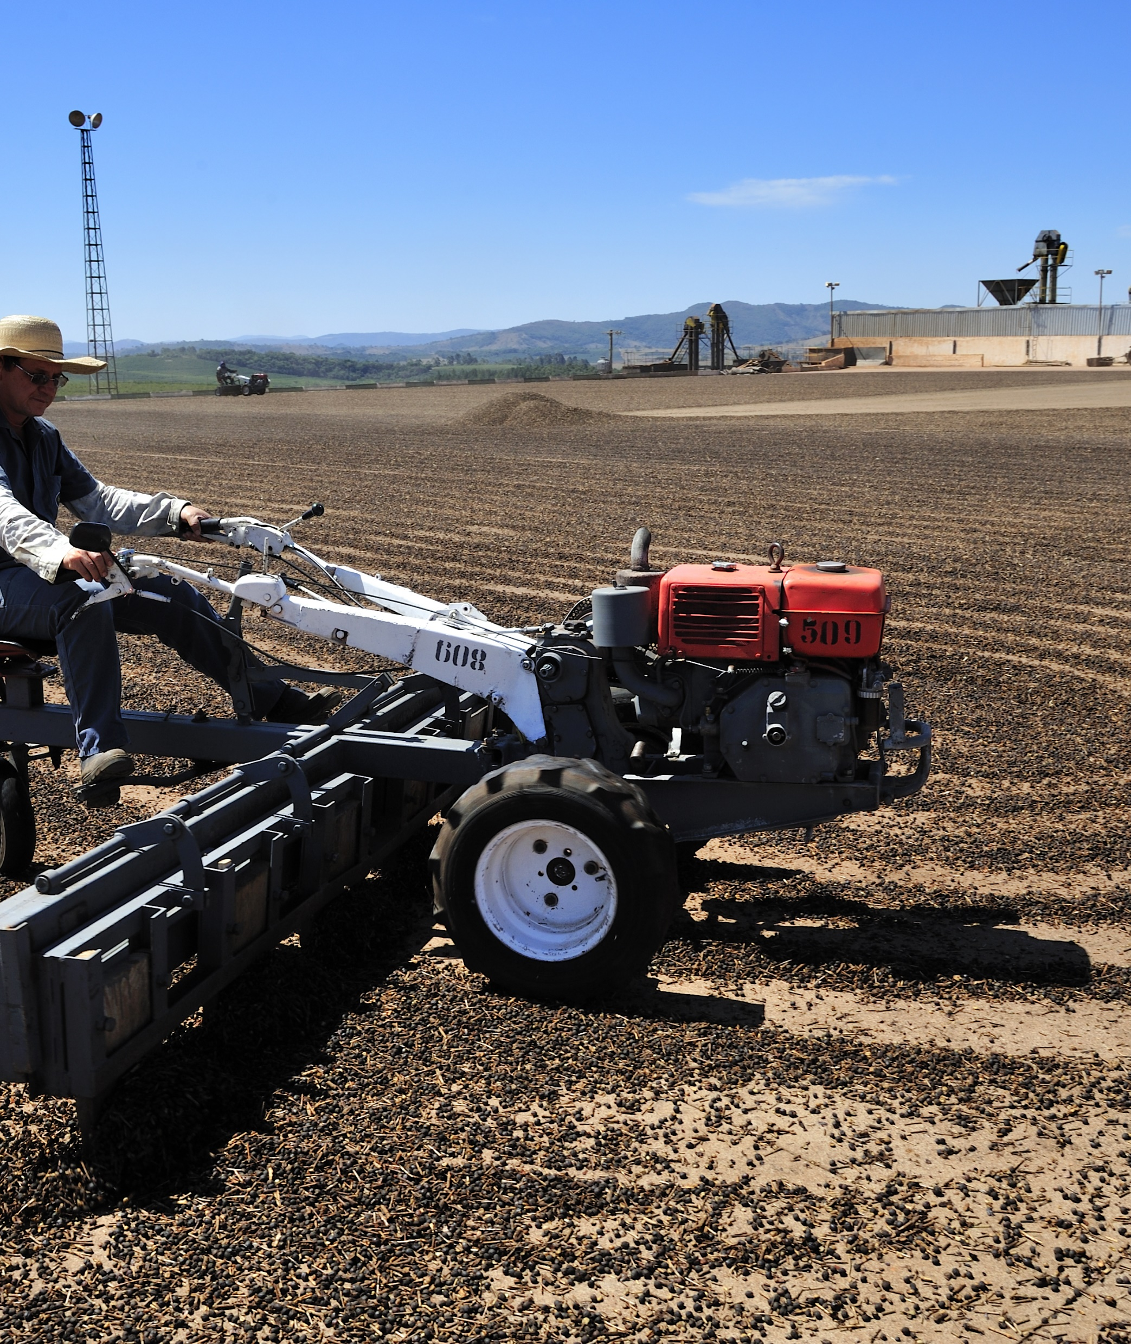
The end

